Slide 1
Data Ware Housing

Slide 2
Define data ware housing:
A data warehouse is a system that centralizes and consolidates large amounts of data from various sources to support business intelligence (BI) activities, especially analytics and reporting.
It acts as a single source of truth for an organization, holding both current and historical data, and is designed to facilitate complex queries and analysis.

Slide 3
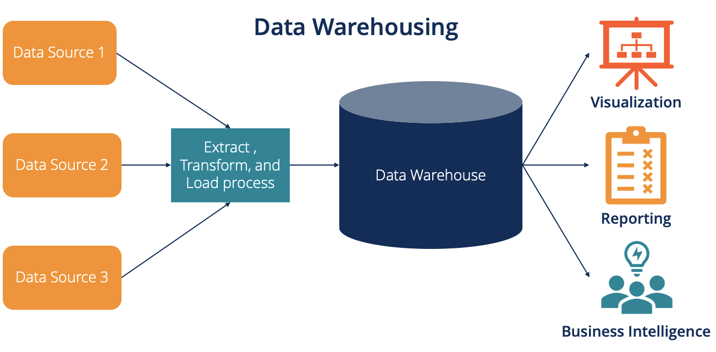

Slide 4
Here's a more detailed explanation:
Centralized Repository: Data warehouses store data from multiple sources (like databases, applications, and external systems) in a single, unified location.
Historical Data: They store not just current data but also historical data, allowing for trend analysis and long-term comparisons.
Structured Format: Data is typically organized in a structured format, often relational, making it suitable for querying and analysis using tools like SQL.

Slide 5
Business Intelligence: Data warehouses are a core component of business intelligence, enabling organizations to make informed decisions based on data insights.
ETL Process: Data is often extracted from various sources, transformed into a consistent format, and then loaded into the warehouse (ETL process).
Types: Data warehouses can be categorized into enterprise data warehouses (EDW), data marts, operational data stores (ODS), and cloud-based or big data warehouses.
Benefits: They help organizations understand trends, identify patterns, improve decision-making, and gain a competitive advantage by leveraging their data assets.

Slide 6
State the importance of Data Ware Housing

Slide 7
Data warehousing is crucial for businesses because it provides a centralized, consistent, and historical view of data, enabling informed decision-making and strategic planning.
It allows for efficient analysis of large datasets, improved data quality, and the ability to track trends over time, ultimately leading to better business outcomes.

Slide 8
importance of data warehousing:
1. Centralized Data Repository:
Data warehouses consolidate data from various operational systems into one place.
This eliminates data silos and provides a single source of truth for analysis.
It makes it easier for users to access and analyze data from different departments and sources.

Slide 9
2. Improved Data Quality and Consistency:
Data warehousing processes often include data cleansing and transformation steps.
This ensures that the data used for analysis is accurate, consistent, and reliable.
Improved data quality leads to more trustworthy insights and better decision-making.
3. Historical Analysis:
Data warehouses store historical data, allowing businesses to track trends, patterns, and performance over time.
This historical perspective is vital for understanding past performance, identifying areas for improvement, and forecasting future trends.
It enables businesses to make data-driven predictions and strategic decisions.

Slide 10
4. Enhanced Business Intelligence (BI):
Data warehouses are the foundation for BI initiatives.
They provide the data needed for reporting, dashboards, and analytical tools.
This enables businesses to monitor key performance indicators (KPIs), track progress, and identify opportunities for growth.
5. Faster Query Performance:
Data warehouses are optimized for analytical queries, allowing for faster retrieval of data compared to operational databases.
This is especially important when dealing with large datasets or complex analyses.
Faster query performance enables users to get the information they need quickly and efficiently.

Slide 11
6. Support for Advanced Analytics:
Data warehouses can be used to support advanced analytical techniques, such as machine learning and data mining.
This allows businesses to uncover hidden patterns, predict future trends, and gain a competitive edge.
7. Improved Decision-Making:
By providing access to a comprehensive and reliable view of data, data warehouses empower businesses to make more informed decisions.
This leads to better strategic planning, improved operational efficiency, and increased profitability.

Slide 12
Differences between Database and Data Ware House

Slide 13
What is Database Management System
Database Management System is used in the traditional way of storing and retrieving data.
The major task of a database system is to perform query processing.
These systems are generally referred to as online transaction processing systems.
These systems are used in the day-to-day operations of any organization.

Slide 14
What is data ware housing
Data warehousing is the process of collecting, storing, and managing large volumes of data from multiple sources in a centralized repository, called a data warehouse, designed for efficient querying, analysis, and reporting.
It organizes data into a structured format, often using schemas like star or snowflake, to support business intelligence activities such as analytics, data mining, and decision-making.
Data is typically historical, aggregated, and optimized for read-heavy operations, unlike operational databases that handle real-time transactions.

Slide 15
Aspect | Database | Data Warehouse
Purpose | Stores and manages real-time, transactional data for daily operations. | Stores and analyzes large volumes of historical data for reporting and analytics.
Data Type | Current, operational data (e.g., customer orders, inventory). | Historical, aggregated data from multiple sources for trend analysis.
Structure | Optimized for CRUD operations (Create, Read, Update, Delete). | Optimized for read-heavy queries and complex analysis.
Schema | Typically uses normalized schemas to reduce redundancy (e.g., 3NF). | Uses denormalized schemas (e.g., star or snowflake) for query efficiency.
Data Volume | Handles smaller, transactional datasets. | Handles massive, aggregated datasets (terabytes to petabytes).

Slide 16
Aspect | Database | Data Warehouse
Processing | OLTP (Online Transaction Processing) for real-time updates. | OLAP (Online Analytical Processing) for complex queries and reporting.
Performance | Fast for transactional operations (inserts, updates, deletes). | Fast for read-heavy, analytical queries on large datasets.
Data Sources | Single or limited sources, often application-specific. | Integrates data from multiple, diverse sources (databases, CRMs, etc.).
Users | Application users, operational staff. | Analysts, data scientists, business executives for decision-making.
Examples | MySQL, PostgreSQL, Oracle Database, MongoDB. | Snowflake, Google BigQuery, Amazon Redshift, Teradata.

Slide 17
Summary: A database is designed for real-time, operational tasks with current data, while a data warehouse is built for analyzing large, historical datasets to uncover insights and trends.Databases prioritize transactional efficiency, while data warehouses focus on analytical performance.

Slide 18
Explain Data Warehouse Architecture

Slide 19
A data warehouse architecture is a structured framework designed to collect, store, and manage large volumes of data from multiple sources for analysis and reporting.
It enables organizations to consolidate data, perform complex queries, and generate insights for decision-making.
Below is a comprehensive explanation of data warehouse architecture, broken down into its key components and layers, presented in a clear and concise manner.

Slide 20
Overview of Data Warehouse Architecture
Data warehouse architecture typically follows a layered approach to process data from raw ingestion to final reporting.
It integrates data from various sources (databases, applications, external systems) into a centralized repository optimized for analytical processing.
The architecture ensures data is cleaned, transformed, and structured for efficient querying and reporting.

Slide 21
Key Components of Data Warehouse Architecture
The architecture is generally organized into several layers, each serving a specific purpose in the data processing pipeline:
1. Data Source Layer
Description: This is the starting point where raw data originates. Data sources include operational systems (e.g., ERP, CRM), databases, flat files, APIs, IoT devices, or external data feeds.
Purpose: Collect raw, transactional data generated from business operations or external sources.
Characteristics: Data is often heterogeneous, unstructured, or semi-structured and not optimized for analysis.
Example: Customer transaction records from a retail POS system, web logs, or social media feeds.

Slide 22
2. Data Ingestion/Extraction Layer Description: This layer involves extracting data from various sources and loading it into the data warehouse.
Processes:
Extraction: Pulling data from source systems.
Transformation: Cleaning, normalizing, and enriching data to ensure consistency and quality.
Loading: Moving data into the staging area or directly into the data warehouse.
Tools: ETL (Extract, Transform, Load) tools like Informatica, Talend, Apache NiFi, or ELT (Extract, Load, Transform) tools for cloud-based systems.
Example: Extracting sales data from a SQL database, removing duplicates, and converting date formats.

Slide 23
3. Data Staging Layer Description: A temporary storage area where raw data is held before processing.
Purpose: Acts as a buffer to clean, validate, and prepare data for transformation without impacting source systems.
Characteristics: Data is not yet fully transformed but is organized for further processing.
Example: Storing raw customer data in a staging database before applying transformations like deduplication or data type standardization.

Slide 24
4. Data Storage Layer (Core Data Warehouse) Description: The central repository where transformed data is stored in a structured format optimized for querying and analysis.
Key Features:
Organized into schemas like star schema or snowflake schema for efficient querying.
Uses fact tables (containing metrics, e.g., sales revenue) and dimension tables (containing descriptive attributes, e.g., customer details).
Often implemented on relational database management systems (RDBMS) like Oracle, SQL Server, or cloud-based solutions like Snowflake, Amazon Redshift, or Google BigQuery.
Purpose: Provide a single source of truth for business data, enabling fast and accurate reporting.
Example: A fact table storing daily sales totals linked to dimension tables for products, customers, and time.

Slide 25
5. Data Processing Layer Description: This layer handles advanced data processing, including aggregations, calculations, and data modeling.
Techniques:
OLAP (Online Analytical Processing): Enables multidimensional analysis for complex queries (e.g., sales by region and product over time).
Data Mining: Identifies patterns and trends in data.
Data Cubes: Pre-aggregated data structures for faster query performance.
Purpose: Support analytical operations like slicing, dicing, drilling down, and roll-ups for business intelligence (BI).
Example: Creating a data cube to analyze sales performance across multiple dimensions (e.g., time, region, product category).

Slide 26
6. Data Access and Presentation Layer Description: The interface through which users access and analyze data in the data warehouse.
Tools: BI tools (e.g., Tableau, Power BI, Looker), reporting tools, or custom dashboards.
Features:
Query tools for ad-hoc analysis (e.g., SQL queries).
Visualizations like charts, graphs, and dashboards.
APIs for integrating with other applications.
Purpose: Deliver actionable insights to end-users, such as analysts, managers, or executives.
Example: A Power BI dashboard showing year-over-year sales growth by product category.

Slide 27
7. Metadata Layer Description: Stores metadata (data about data) to manage and document the data warehouse.
Types:
Technical Metadata: Information about data structures, schemas, and ETL processes.
Business Metadata: Definitions of business terms, KPIs, and reports.
Purpose: Facilitates data governance, lineage tracking, and user understanding of the data.
Example: Metadata describing the source of a "sales" metric and its calculation logic.

Slide 28
8. Data Governance and Security Layer Description: Ensures data quality, security, and compliance with regulations (e.g., GDPR, HIPAA).
Features:
Access controls to restrict data access based on user roles.
Data encryption for sensitive information.
Auditing and monitoring to track data usage.
Purpose: Protect data integrity and ensure compliance with organizational and legal standards.
Example: Role-based access ensuring only authorized users can view customer financial data.

Slide 29
Common Data Warehouse Architectures
Data warehouse architectures can vary based on organizational needs and technology. The main types include:
1. Traditional Data Warehouse (On-Premises) Hosted on local servers with a monolithic architecture.
Uses ETL processes and relational databases (e.g., Oracle, Teradata).
Suitable for organizations with strict data control requirements.
Pros: High control, customizable.
Cons: High maintenance costs, limited scalability.

Slide 30
2. Cloud-Based Data Warehouse Hosted on cloud platforms like AWS Redshift, Google BigQuery, or Snowflake.
Uses ELT processes, leveraging cloud scalability.
Pros: Scalable, cost-effective, easy to integrate with other cloud services.
Cons: Potential dependency on cloud providers.
3. Data Lakehouse : Combines data warehouse and data lake features, allowing storage of structured and unstructured data.
Uses tools like Databricks or Delta Lake.
Pros: Flexible for advanced analytics (e.g., machine learning), cost-efficient.
Cons: Complex to implement and manage.

Slide 31
4. Federated Data Warehouse Integrates multiple data warehouses or databases without physically consolidating them.
Uses virtual layers to query distributed data sources.
Pros: Avoids data duplication, supports decentralized environments.
Cons: Can be slower due to distributed querying.

Slide 32
Key Design Considerations
Scalability: Ensure the architecture can handle growing data volumes.
Performance: Optimize for fast query execution using indexing, partitioning, or caching.
Data Quality: Implement robust ETL processes to ensure accuracy and consistency.
Flexibility: Design to accommodate new data sources and evolving business needs.
Cost: Balance performance with infrastructure costs, especially in cloud environments.

Slide 33
Example Workflow
Data Ingestion: Sales data from an e-commerce platform is extracted via an ETL tool.
Staging: Raw data is cleaned (e.g., removing null values) in a staging database.
Storage: Transformed data is loaded into a star schema in a cloud data warehouse like Snowflake.
Processing: OLAP cubes are created to analyze sales by region and product.
Presentation: A Tableau dashboard displays sales trends to business users.
Governance: Metadata tracks data lineage, and access controls limit sensitive data to authorized users.

Slide 34
Modern Trends:
Cloud Adoption: Shift to cloud-based solutions for scalability and cost efficiency.
Real-Time Data Warehousing: Streaming data integration for near-real-time analytics (e.g., using Apache Kafka).
AI and Machine Learning: Integration with AI tools for predictive analytics.
Data Mesh: Decentralized architecture for domain-driven data management.

